Slide 1
Introduction to Apache Spark
Slavko Žitnik
University of Ljubljana, Faculty for computer and information science

Slide 2
Agenda
About Apache Spark
Spark execution modes
Basic Spark data structures (RDDs, DataFrames, ...)
Hands-on tutorial (Python REPL)
RDDs and operations
DataFrames, User defined functions and SparkSQL
Hands-on lab exercises – Jupyter notebooks
Hands-on lab exercise – Spark on an HPC
Apache Spark deployment using Slurm
Challenge exercises (independent work) & debug session

Slide 3
About Apache Spark
Fast, expressive, general-purpose in-memory cluster computing framework compatible with Apache Hadoop and built around speed, ease of use and streaming analytics
Faster and easier than Hadoop MapReduce*
Large community and 3rd party libraries
Provides high-level APIs (Java, Scala, Python, R)
Supports variety of workloads
interactive queries, streaming, machine learning and graph processing

Slide 4
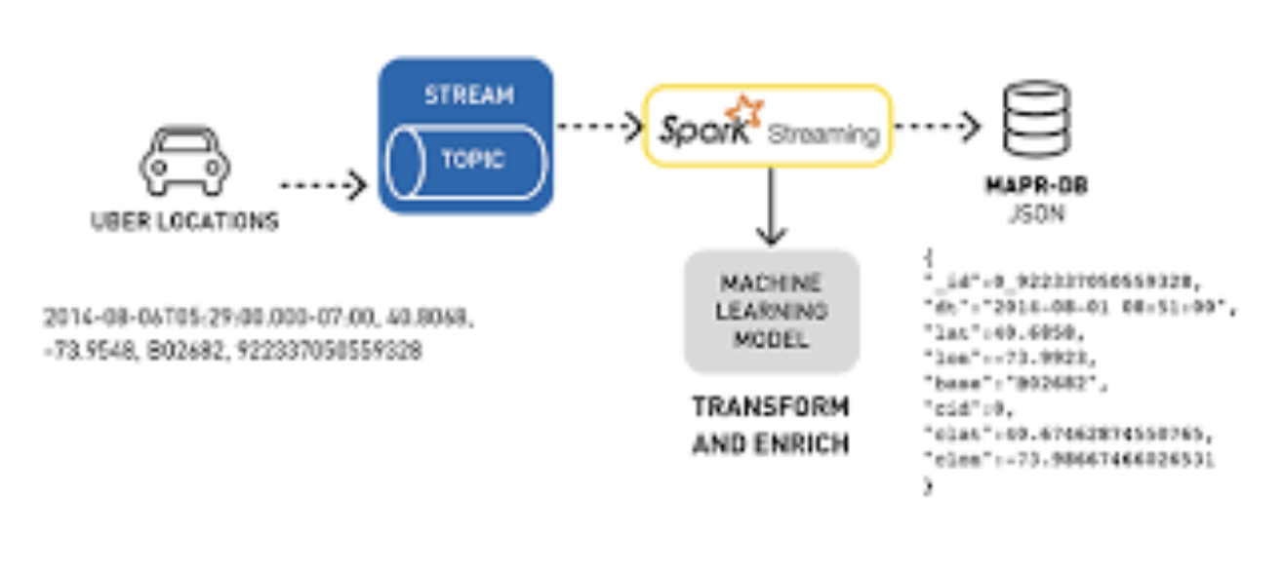
Apache Spark Use cases
Logs processing (Uber)
Event detection and real-time analysis
Interactive analysis
Latency reduction
Advanced ad-targeting (Yahoo!)
Recommendation systems (Netflix, Pinterest)
Fraud detection
Sentiment analysis (Twitter)
...

Slide 5
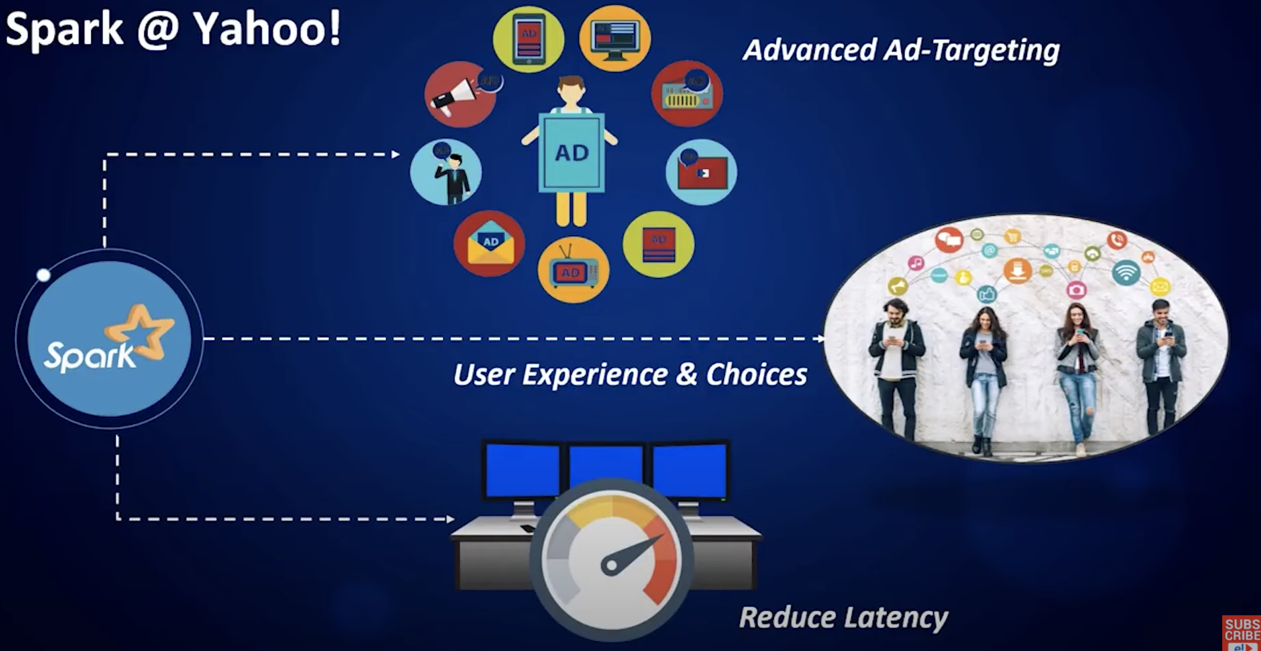
Apache Spark Use cases
Logs processing (Uber)
Event detection and real-time analysis
Interactive analysis
Latency reduction
Advanced ad-targeting (Yahoo!)
Recommendation systems (Netflix, Pinterest)
Fraud detection
Sentiment analysis (Twitter)
...

Slide 6
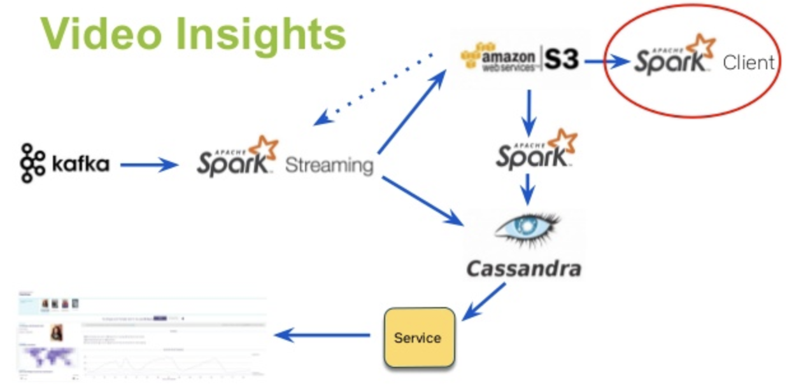
Apache Spark Use cases
Logs processing (Uber)
Event detection and real-time analysis
Interactive analysis
Latency reduction
Advanced ad-targeting (Yahoo!)
Recommendation systems (Netflix, Pinterest)
Fraud detection
Sentiment analysis (Twitter)
...

Slide 7
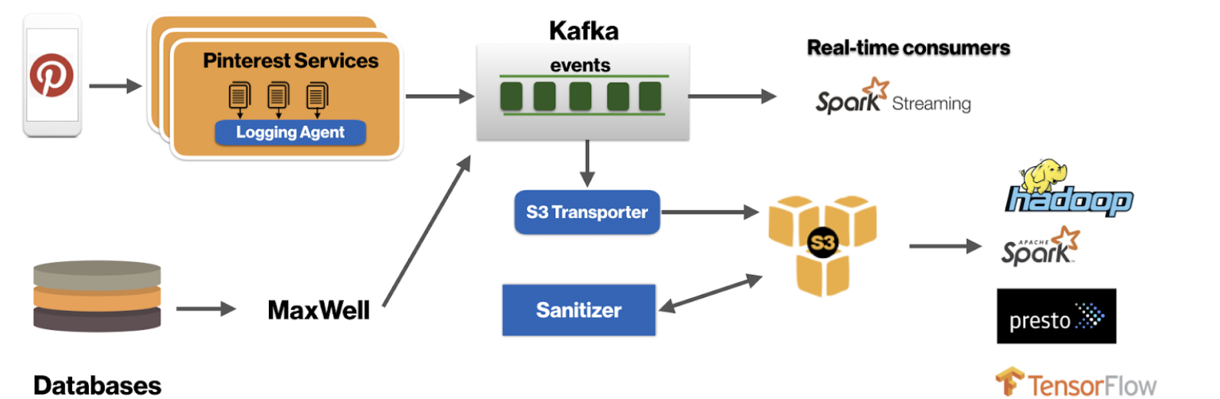
Apache Spark Use cases
Logs processing (Uber)
Event detection and real-time analysis
Interactive analysis
Latency reduction
Advanced ad-targeting (Yahoo!)
Recommendation systems (Netflix, Pinterest)
Fraud detection
Sentiment analysis (Twitter)
...

Slide 8
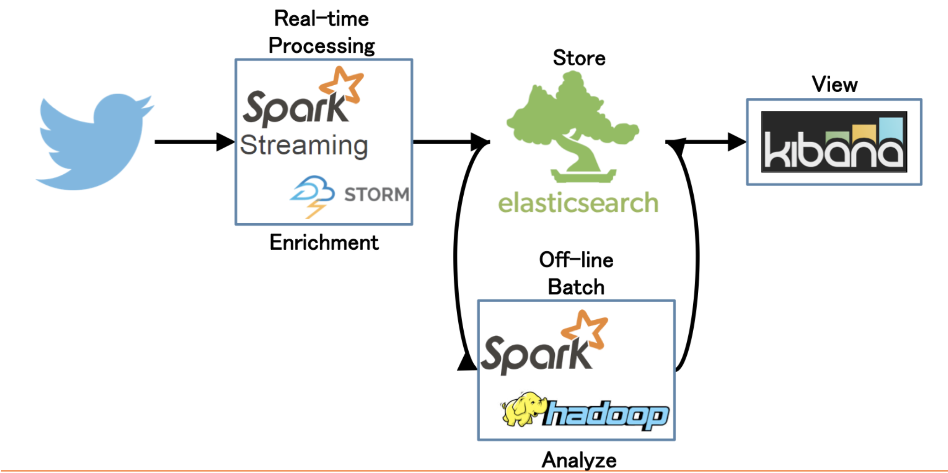
Apache Spark general setup: Twitter sentiment analysis

Slide 9
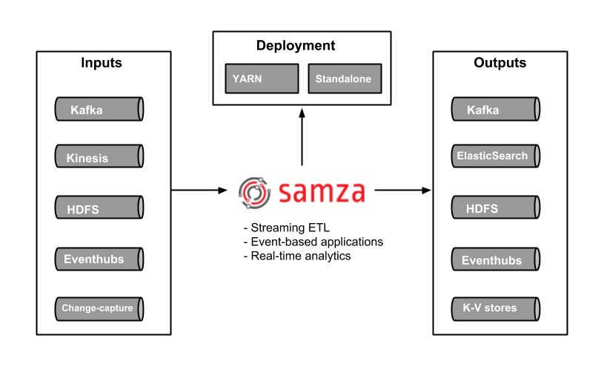
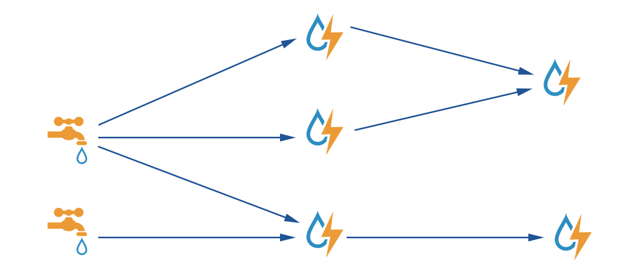
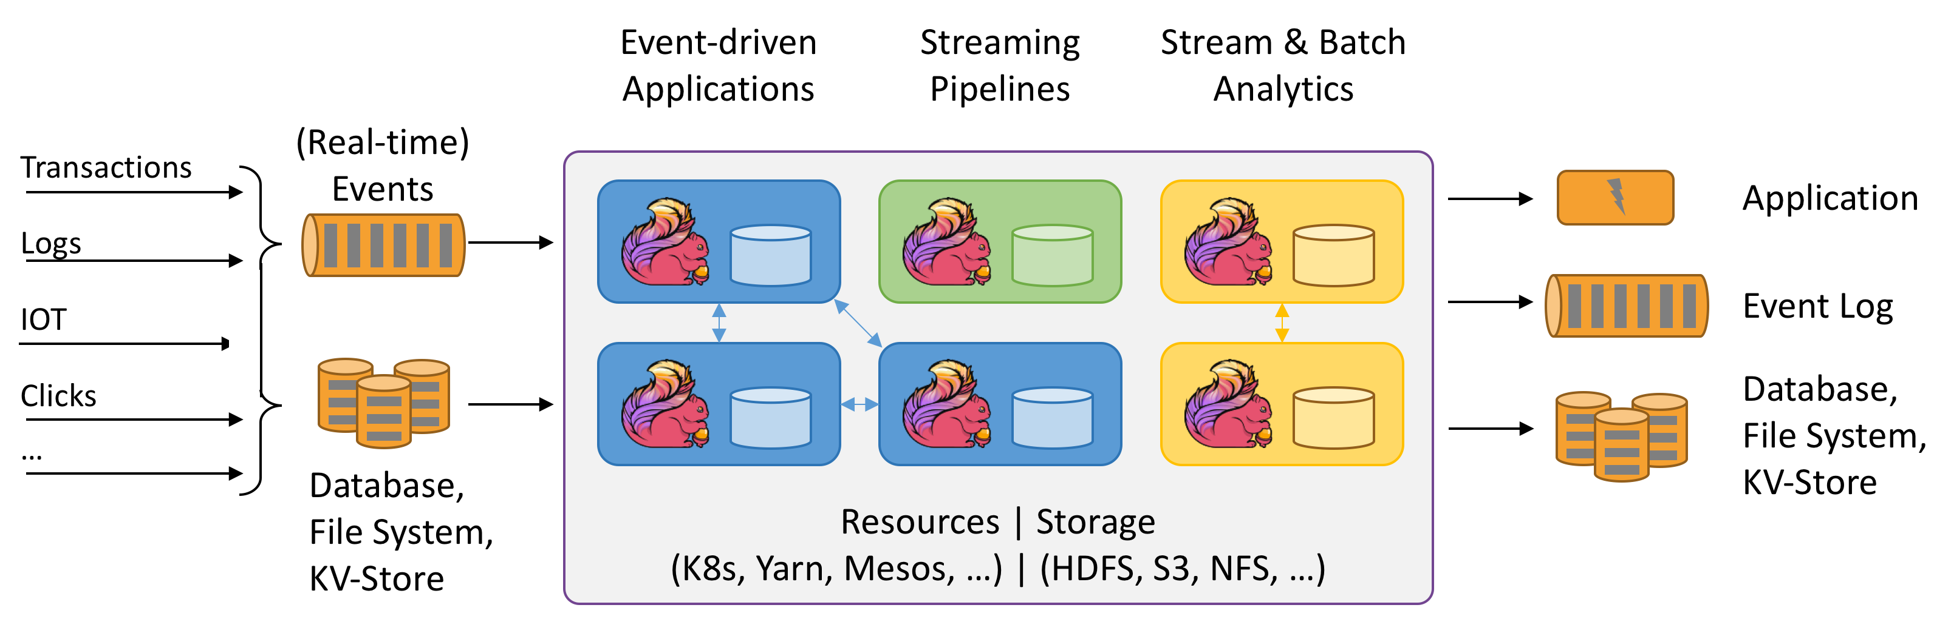


Apache Spark alternatives
Apache Samza (library/framework)
Apache Storm (real-time stream processing)
Apache Flink (native streaming support for all workloads)

Slide 10
Apache Spark 3
Latest release – v3.1.1. (March 2, 2021)
Improvements over Spark 2 (v2.4.1)
Python 2 deprecated
Adaptive execution of Spark SQL (merging intermediate results among workers)
Dynamic partition pruning
Support for deep learning (GPU support for Nvidia, AMD, Intel)
Better Kubernetes integration
Graph features (Morpheus as extension of Cypher, neo4j support)
ACID transactions (for Delta Lake storage)
Apache Arrow data format integration (columnar format for analytics)
...

Slide 11
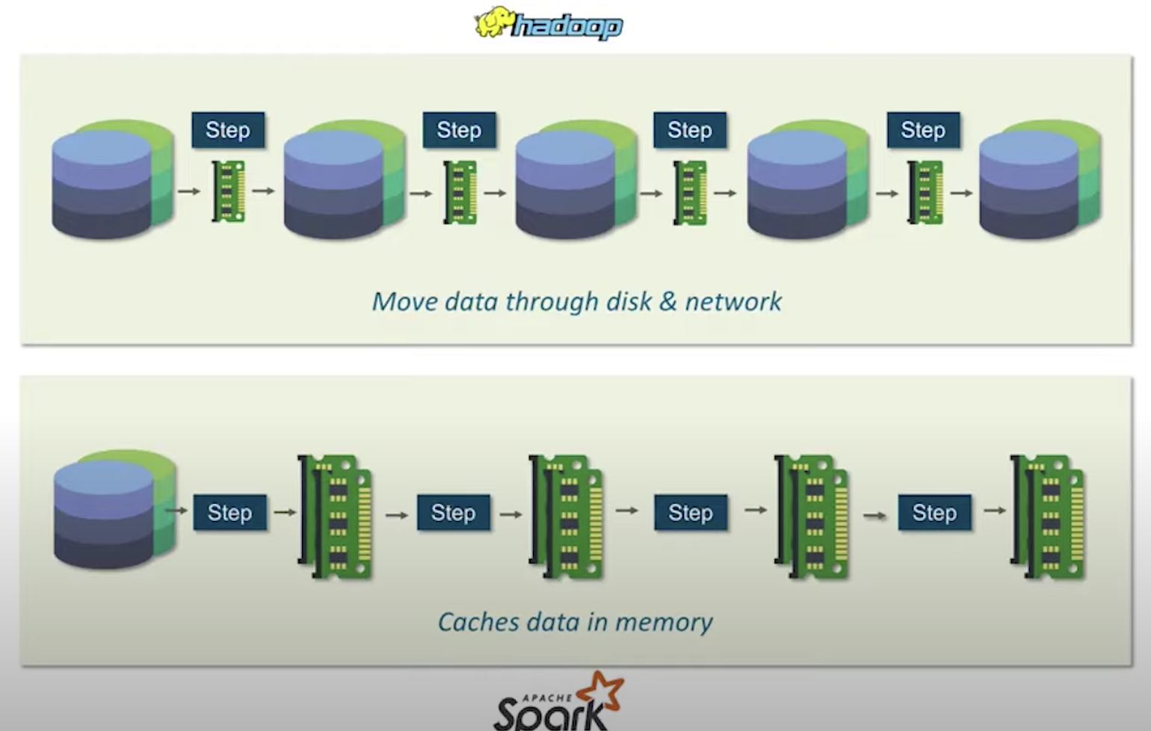
Hadoop MapReduce vs. Apache Spark
Big data frameworks
Performance
Ease of use
Costs
Data processing
Fault tolerance
Security
Hadoop
Archival data analysis
Spark (micro-batch model)
Real-time data analysis

Slide 12
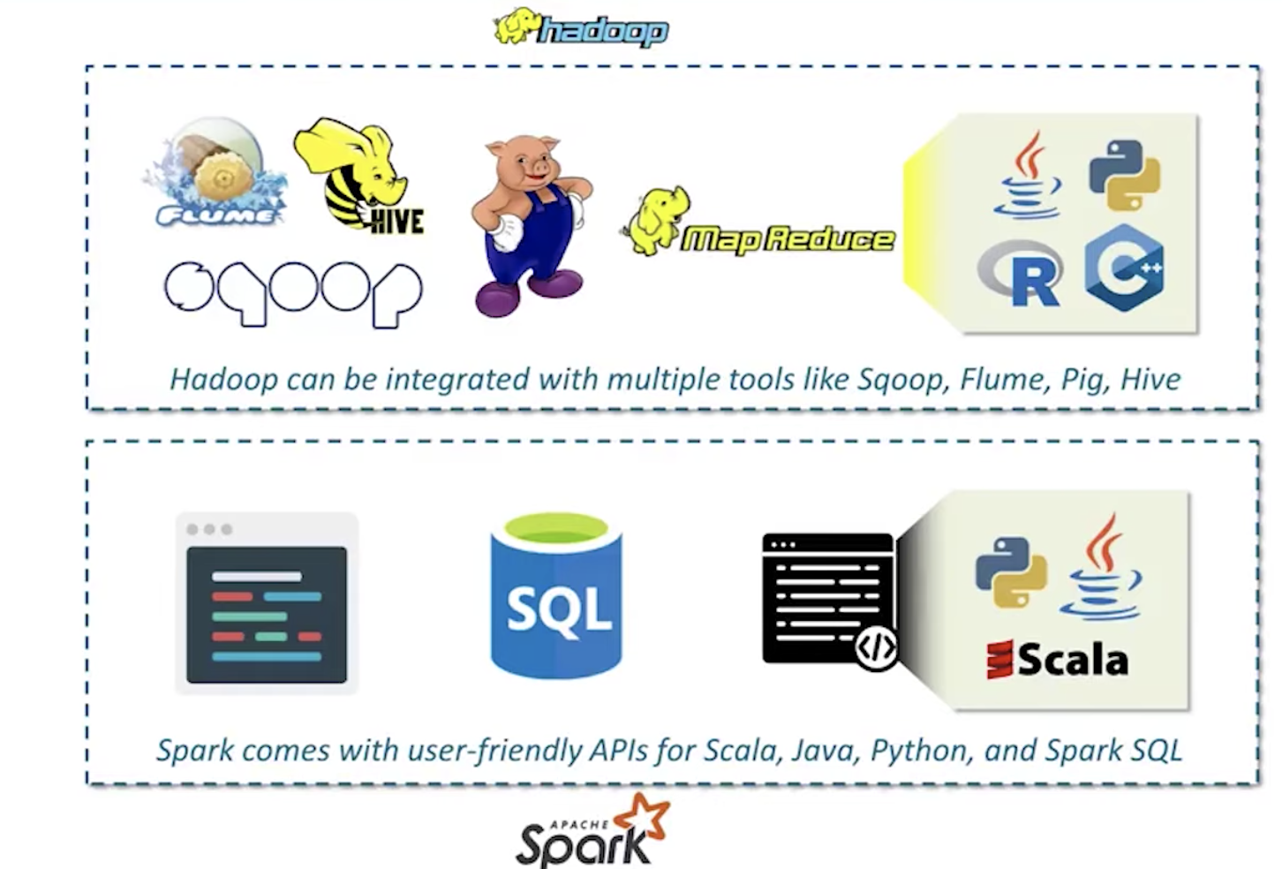
Hadoop MapReduce vs. Apache Spark
Big data frameworks
Performance
Ease of use
Costs
Data processing
Fault tolerance
Security
Hadoop
Archival data analysis
Spark (micro-batch model)
Real-time data analysis

Slide 13
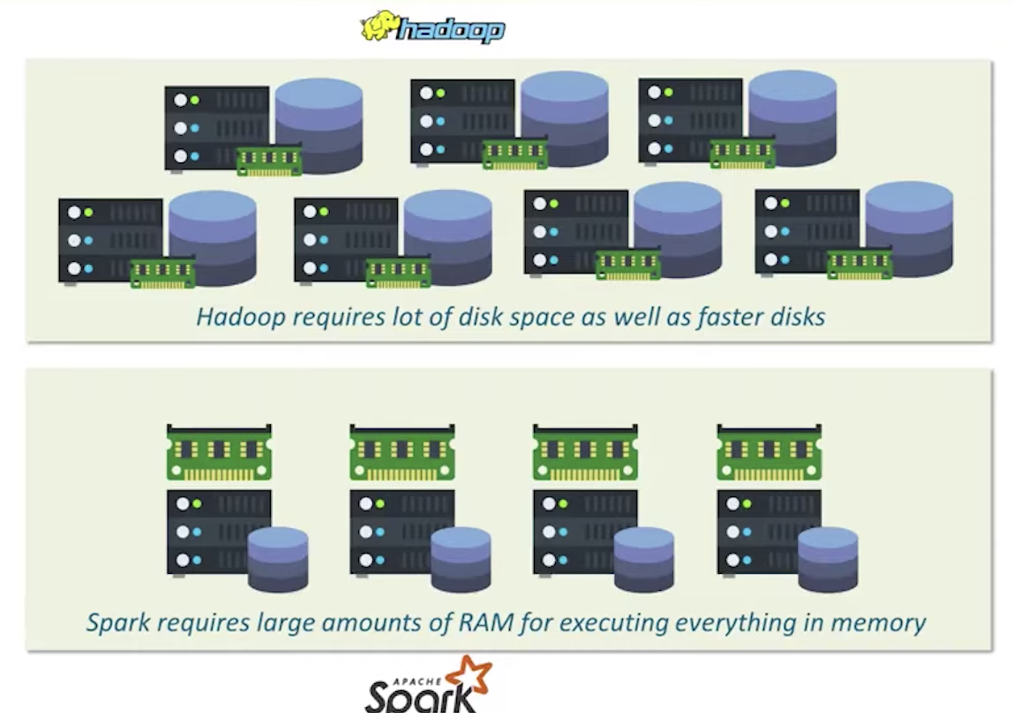
Hadoop MapReduce vs. Apache Spark
Big data frameworks
Performance
Ease of use
Costs
Data processing
Fault tolerance
Security
Hadoop
Archival data analysis
Spark (micro-batch model)
Real-time data analysis

Slide 14
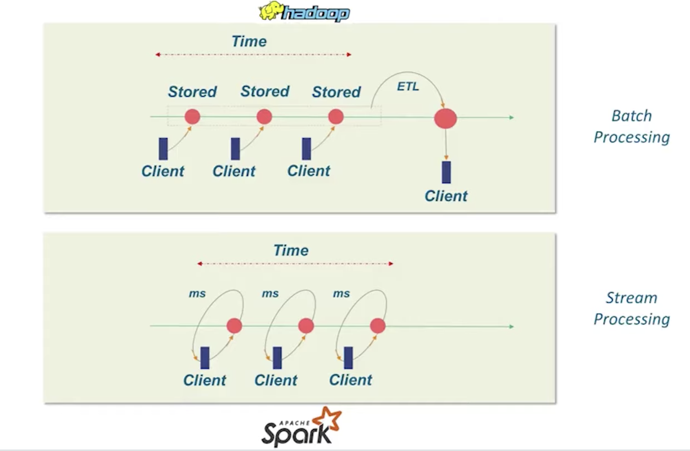
Hadoop MapReduce vs. Apache Spark
Big data frameworks
Performance
Ease of use
Costs
Data processing
Fault tolerance
Security
Hadoop
Archival data analysis
Spark (micro-batch model)
Real-time data analysis

Slide 15
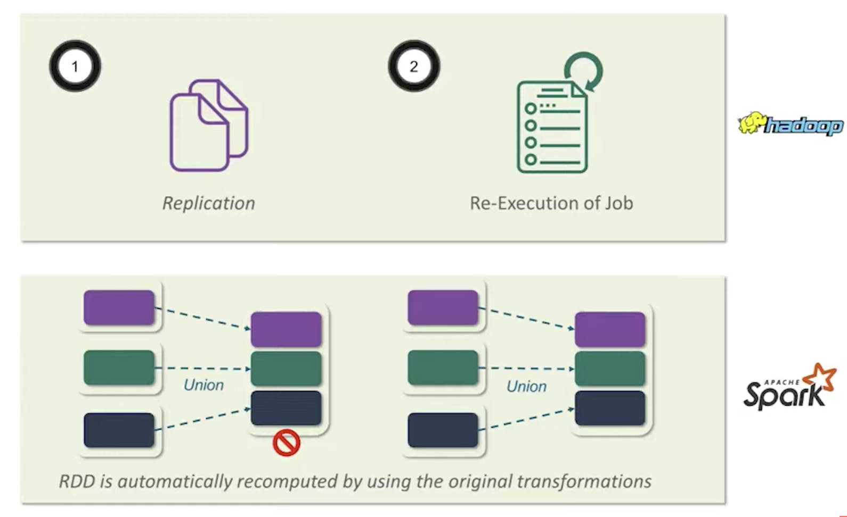
Hadoop MapReduce vs. Apache Spark
Big data frameworks
Performance
Ease of use
Costs
Data processing
Fault tolerance
Security
Hadoop
Archival data analysis
Spark (micro-batch model)
Real-time data analysis

Slide 16
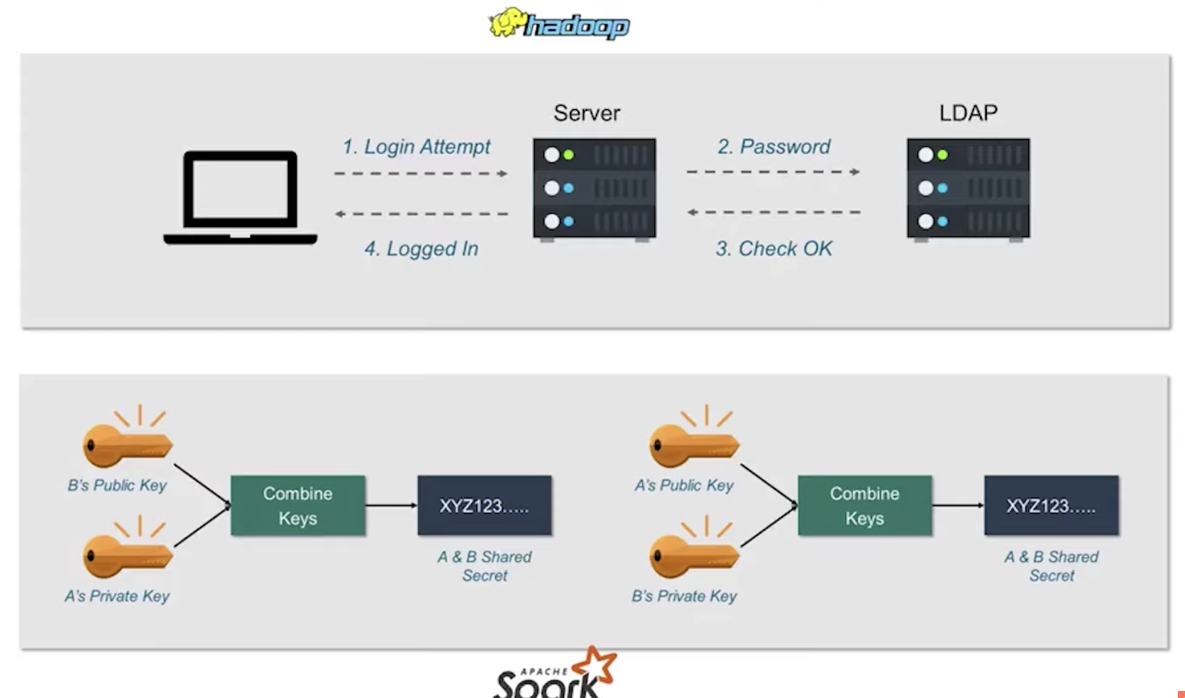
Hadoop MapReduce vs. Apache Spark
Big data frameworks
Performance
Ease of use
Costs
Data processing
Fault tolerance
Security
Hadoop
Archival data analysis
Spark (micro-batch model)
Real-time data analysis

Slide 17
Apacke Spark ecosystem

Slide 18
Spark ecosystem: Spark core
Core functionalities
task scheduling
memory management
fault recovery
storage systems interaction
etc.
Basic data structure definitions/abstractions
Resilient Distributed Data sets (RDDs)
main Spark data structure
Directed Acyclic Graph (DAG)

Slide 19
Spark ecosystem: Spark SQL
Structured data manipulation
Data Frames definition
Table-like data representation
RDDs extension
Schema definition
SQL queries execution
Native support for schema-based data
Hive, Paquet, JSON, CSV

Slide 20
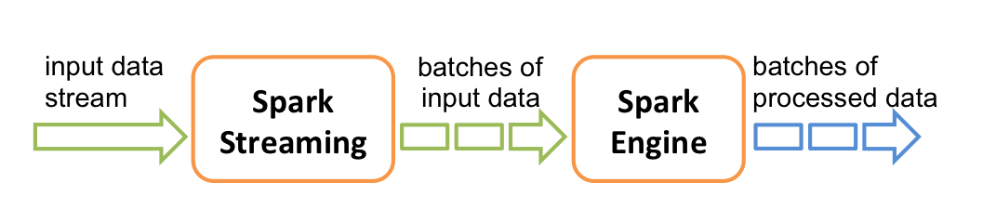
Spark ecosystem: Streaming
Data analysis of streaming data
e.g. tweets, log messages
Features of stream processing
High-troughput
Fault-tolerant
End-to-end
Exactly-once
High-level abstraction of a discretized stream
Dstream represented as a sequence of RDDs
Spark 2.3+ , Continuous Processing
end-to-end latencies as low as 1ms

Slide 21
Spark ecosystem: MLlib
Common ML functionalities
ML Algorithms
common learning algorithms such as classification, regression, clustering, and collaborative filtering
Featurization
feature extraction, transformation, dimensionality reduction, and selection
Pipelines
tools for constructing, evaluating, and tuning ML Pipelines
Persistence
saving and load algorithms, models, and Pipelines
Utilities
linear algebra, statistics, data handling, etc.
Two APIs
RDD-based API (spark.mllib package)
Spark 2.0+, DataFrame-based API (spark.ml package)
Methods scale out across the cluster by default

Slide 22
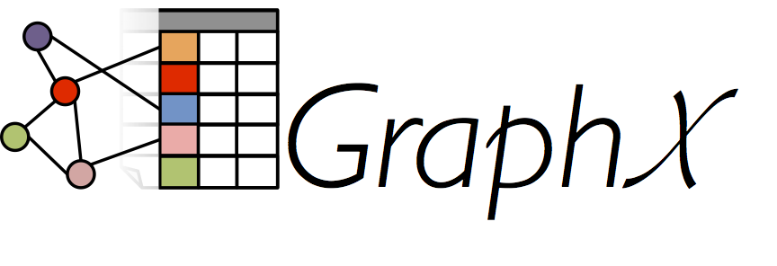
Spark ecosystem: GraphX
Support for graphs and graph-parallel computation
Extension of RDDs (Graph)
directed multigraph with properties on vertices and edges
Graph computation operators
subgraph, joinVertices, and aggregateMessages, etc.
PregelAPI support

Slide 23
Spark Execution modes
Local mode
„Pseudo-cluster“ ad-hoc setup using script
Cluster mode
Running via cluster manager
Interactive mode
Direct manipulation in a shell (pyspark, spark-shell)

Slide 24
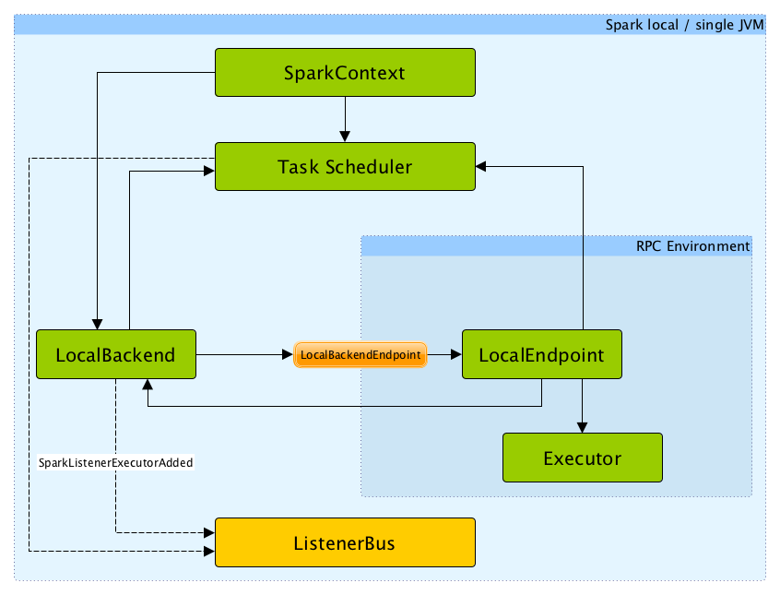
Spark execution modes Local mode
Non-distributed single-JVM deployment mode
Spark library spawns (in a JVM)
driver
scheduler
master
executor
Parallelism is the number of threads defined by a parameter N in a spark master URL
local[N]

Slide 25
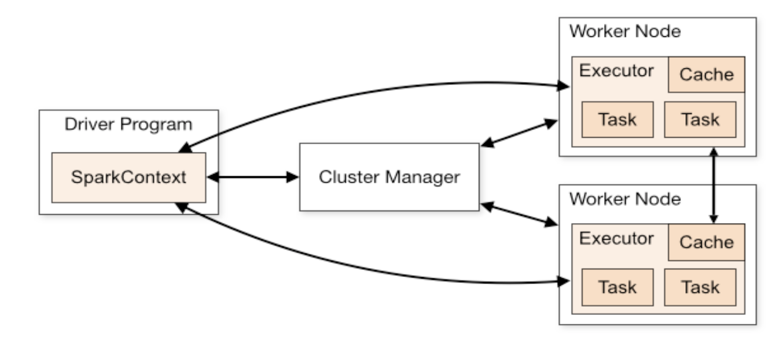
Spark execution modes Cluster mode
Deployment on a private cluster
Apache Mesos
Hadoop YARN
Kubernetes
Standalone mode, ...

Slide 26
Spark execution modes Cluster mode
Components
Worker
Node in a cluster, managed by an executor
Executor manages computation, storage and caching
Cluster manager
Allocates resources via SparkContext with Driver program
Driver program
A program holding SparkContext and main code to execute in Spark
Sends application code to executors to execute
Listens to incoming connections from executors

Slide 27
Spark execution modes Cluster mode
Deploy modes (standalone clusters)
Client mode (default)
Driver runs in the same process as client that submits the app
Cluster mode
Driver launched from a worker process
Client process exits immediately after application submission

Slide 28
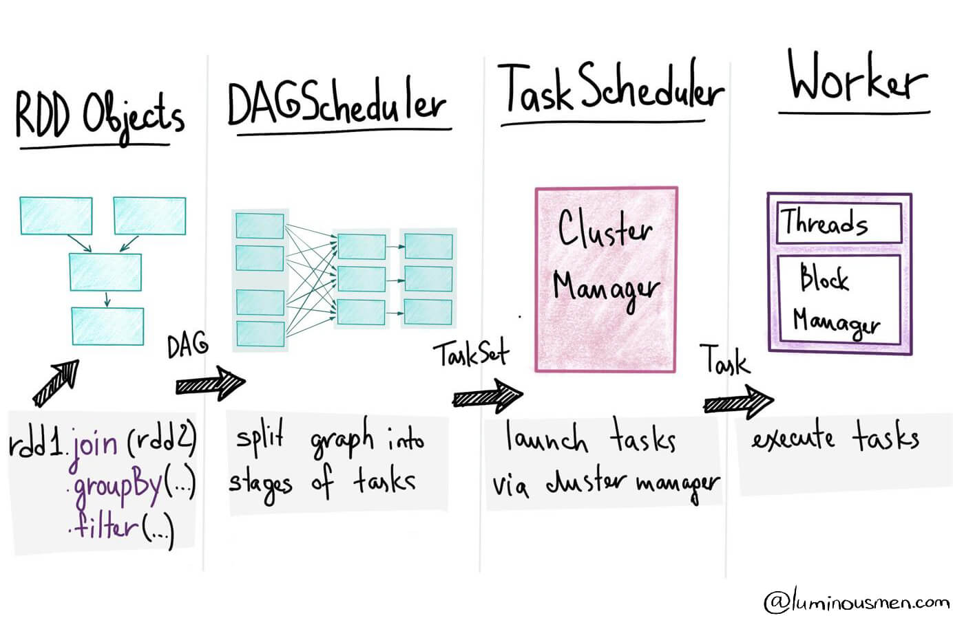
Spark Execution process
Data preparation/import
RDDs creation – i.e. parallel dataset with partitions
Transformations/actions definition*
Creation of tasks (units of work) sent to one executor
Job is a set of tasks executed by an action*
Creation of a directed acyclic graph (DAG)
Contains a graph of RDD operations
Defition of stages – set of tasks to be executed in parallel (i.e. at a partition level)
Execution of a program

Slide 29
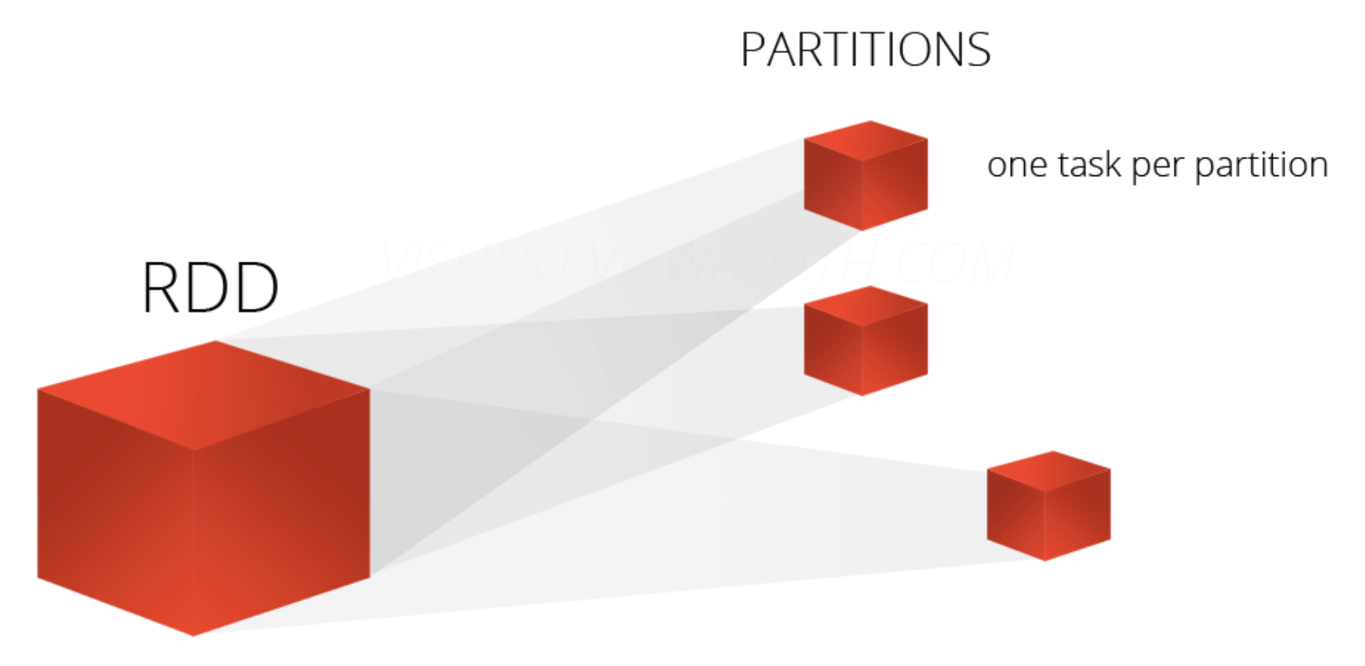
Spark Programming concepts (Resilient distributed datasets - RDDs)
Basic data representation in Spark
A distributed collection of items – partitions
Enables operations to be performed in parallel
Immutable (read-only)
Fault tolerant
“Recipe“ of data transformations is preserved, so a partition can be re-created at any time
Caching
Different storage levels possible
Supports a set of Spark transformations and actions

Slide 30
Spark Programming concepts (Resilient distributed datasets - RDDs)
Computations are expressed using
creation of new RDDs
transforming existing RDDs
operations on RDDs to compute results (actions)
Distributes the data within RDDs across nodes (executors) in the cluster and parallelizes calculations

Slide 31
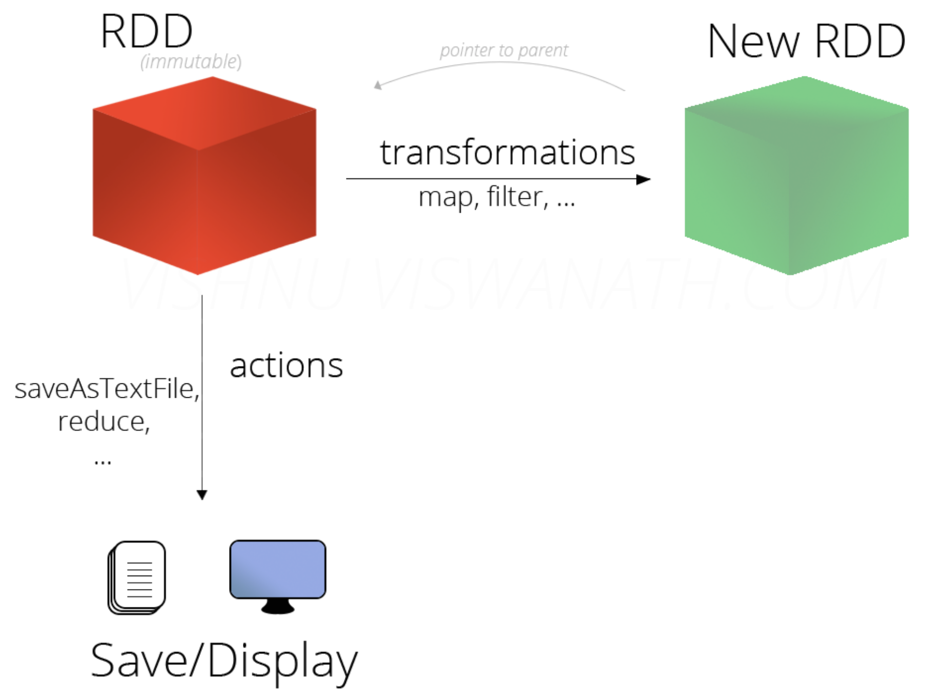
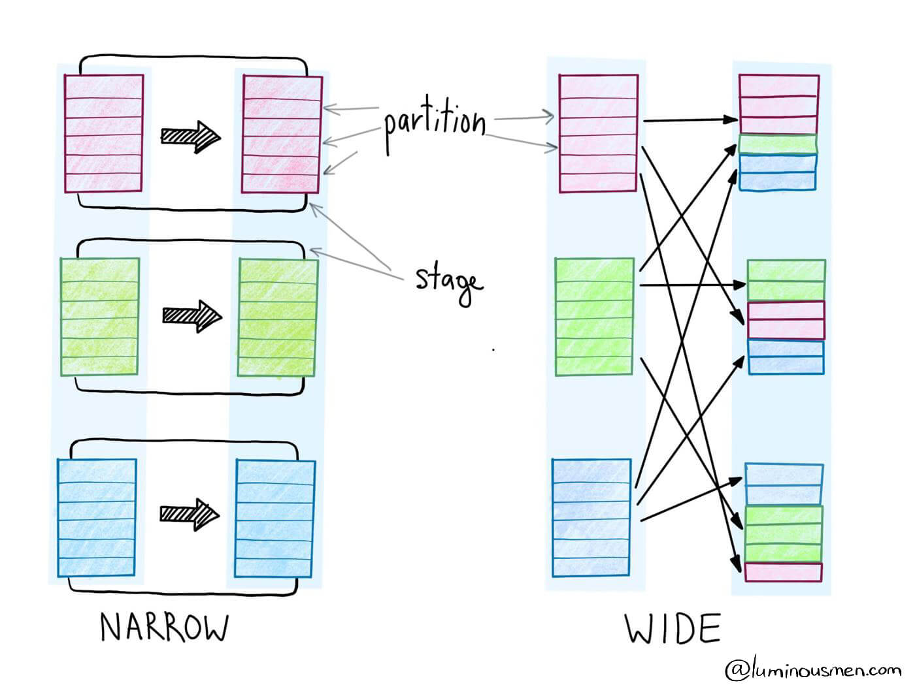
RDD Operations
RDDs enable following operations
transformations
lazy operations that return a new RDD from input RDDs
narrow or wide types
examples: map, filter, join, groupByKey...
actions
return a result or write to storage, execute transformations
examples: count, collect, save

Slide 32
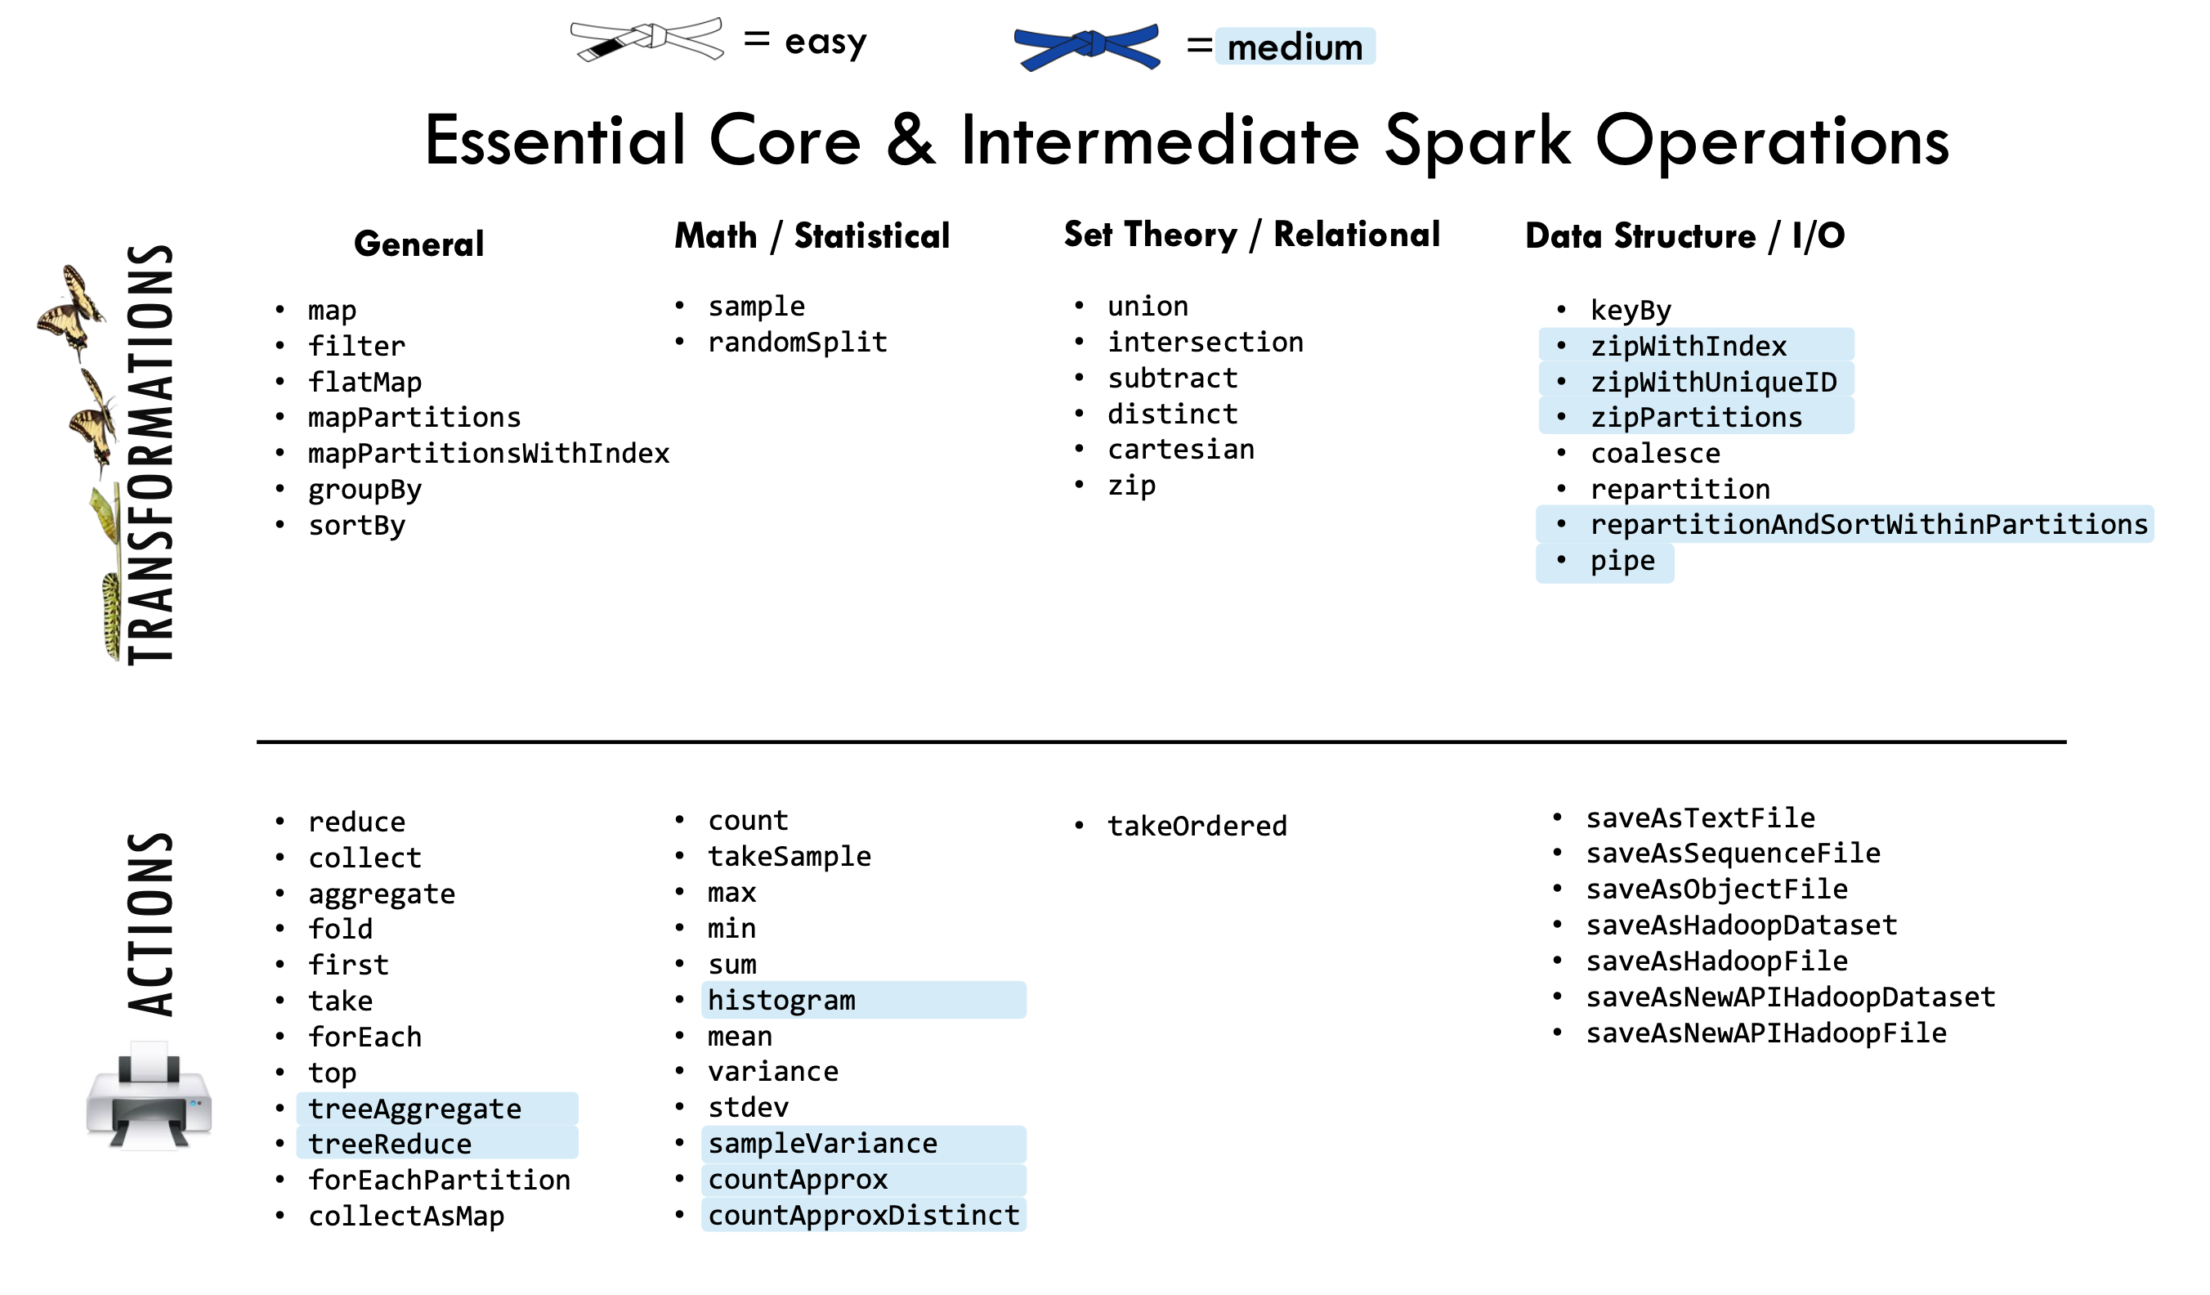
RDD Transformations vs. actions

Slide 33
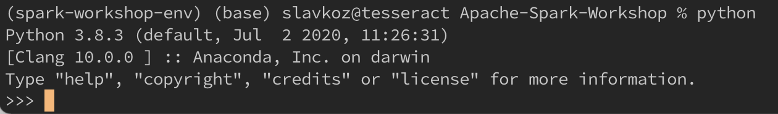
Hands On Preparation
Clone Workshop Git repository and enter its folder
git clone https://github.com/szitnik/Apache-Spark-Workshop.git
cd Apache-Spark-Workshop
Create virtual environment, install libraries and run Python 3 REPL
$ python3 -m venv spark-workshop-env
$ . spark-workshop-env/bin/activate
(spark-workshop-env)$ pip install --upgrade pip
(spark-workshop-env)$ pip install jupyter jupyterlab pyspark===3.1.1
(spark-workshop-env)$ pip install ipykernel
(spark-workshop-env)$ python -m ipykernel install --name=DSSpark
(spark-workshop-env)$ python

Slide 34
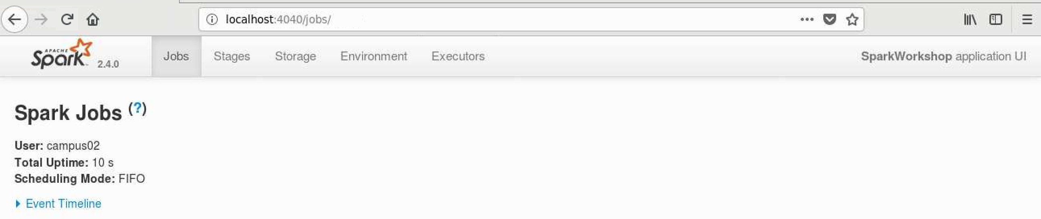
RDDs in Spark
We will use pySpark library interactively
import pyspark
sc = pyspark.SparkContext(appName='SparkWorkshop', master='local[1]')

Slide 35
RDDs in Spark
Creation of RDDs
From a collection
rdd1 = sc.parallelize([('John', 23), ('Mark', 11), ('Jenna', 44), ('Sandra', 61)])
From a file
rdd2 = sc.textFile('data/IMDB Dataset.csv')
Basic transformations map(), filter(), flatMap()
older = rdd1.filter(lambda x: x[1] > 18)
anonymized = older.map(lambda x: (x[0][0], x[1]))
birthdays = rdd1.map(lambda x: list(range(1, x[1]+1)))
birthdays = rdd1.flatMap(lambda x: list(range(1, x[1]+1)))
birthdays.map(lambda x: (x, 1)).groupByKey() \
.mapValues(lambda vals: len(list(vals))).sortByKey()

Slide 36
RDDs in Spark
Further actions, transformations
rdd2.take(2)
def organize(line):
data = line.split('",')
data = data if len(data) == 2 else line.split(',')
return (data[1], data[0][1:51] + ' ...')
movies = rdd2.filter(lambda x: x != 'review,sentiment').map(organize)
movies.count() // 50.000
movies = movies.filter(lambda x: x[0] in ['positive', 'negative'])
movies.count() // 45.936
movieCounts = movies.groupByKey().map(lambda x: (x[0], len(x[1])))
Notes:
Tu je problem, ker CSV ni generiran ok in se pojavljajo napake pri branju,

Slide 37
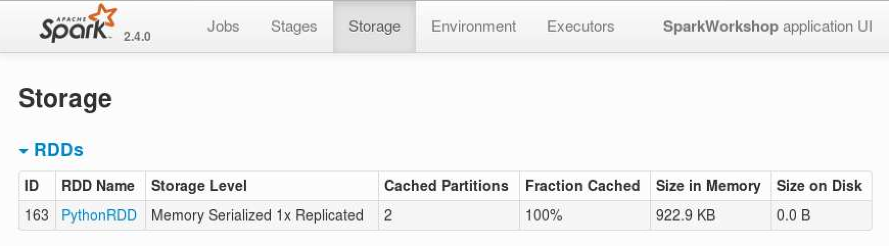
RDDs in Spark
Caching
movies.take(2)
posReviews = movies.filter(lambda x: x[0] == 'positive').map(lambda x: x[1])
negReviews = movies.filter(lambda x: x[0] == 'negative').map(lambda x: x[1])
posReviews.cache().collect()
Notes:
Tu je problem, ker CSV ni generiran ok in se pojavljajo napake pri branju,

Slide 38
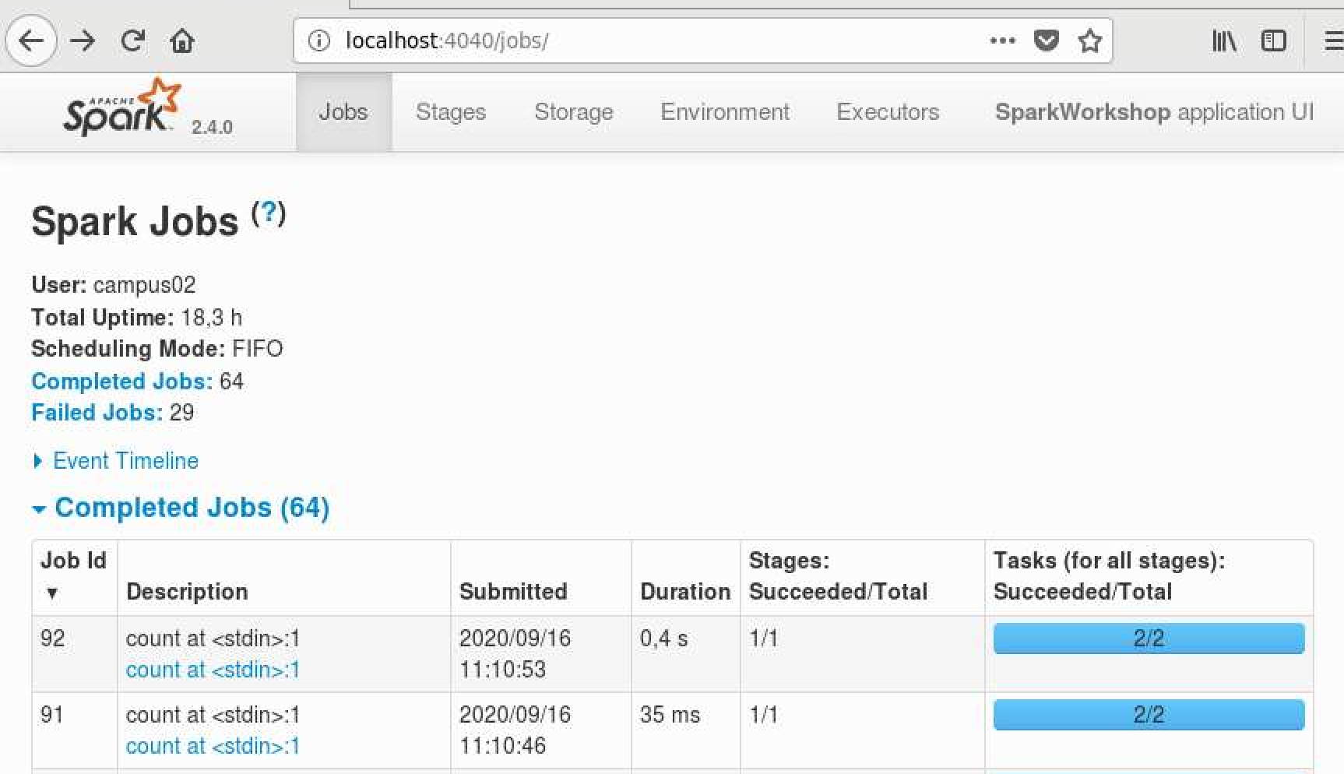
RDDs in Spark
Caching
posReviews.filter(lambda x: 'good' in x).count() //605
negReviews.filter(lambda x: 'bad' in x).count() //788
Notes:
Tu je problem, ker CSV ni generiran ok in se pojavljajo napake pri branju,

Slide 39
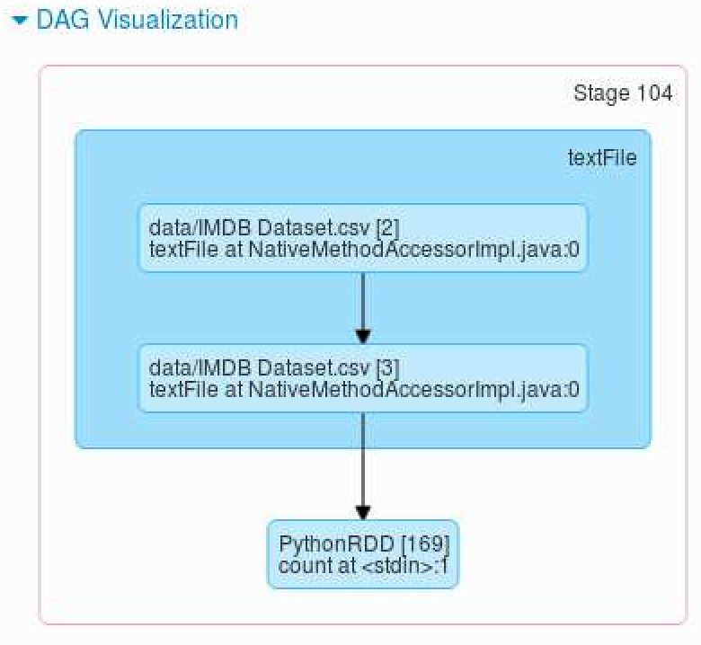
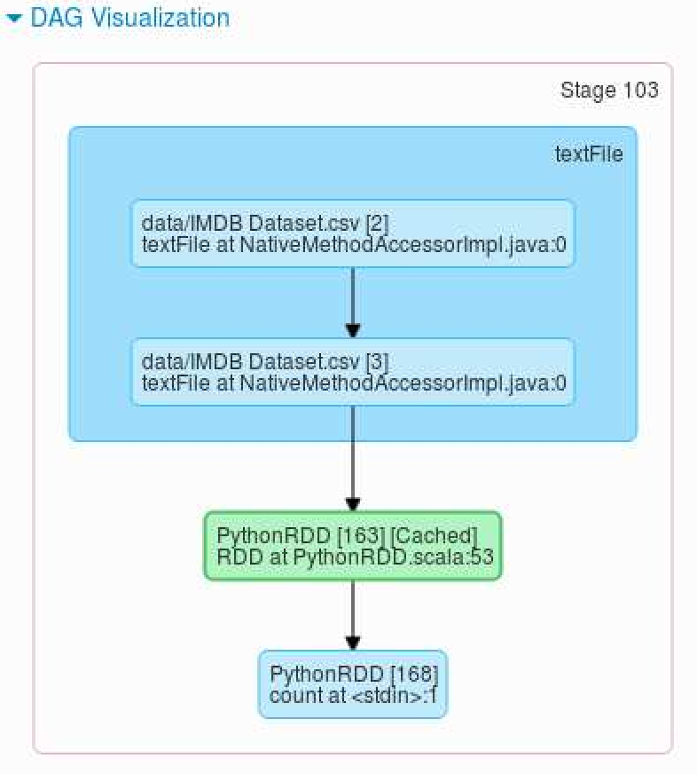
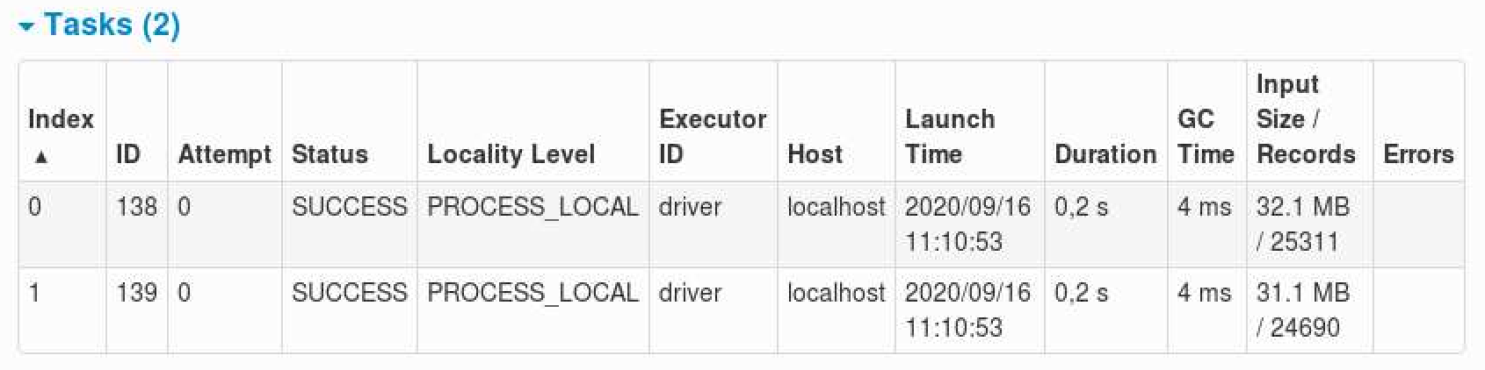
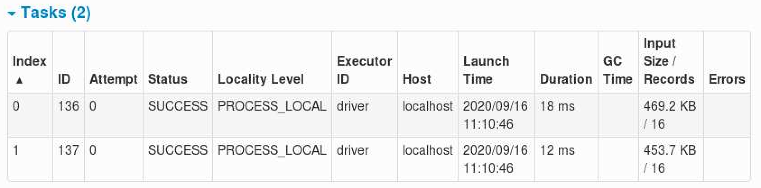
RDDs in Spark
Notes:
Tu je problem, ker CSV ni generiran ok in se pojavljajo napake pri branju,

Slide 40
RDDs in Spark
DAG exploration
def splitLine(line):
return line.replace(',', ' ').replace('"', ' ').replace('.', ' ').split()
rdd2 = sc.textFile('data/IMDB Dataset.csv', 4)
wordCounts = rdd2.flatMap(splitLine).map(lambda word: (word, 1)). \
reduceByKey(lambda a,b: a+b, 3)
wordCounts.takeOrdered(10, key = lambda x: -x[1])
Notes:
Tu je problem, ker CSV ni generiran ok in se pojavljajo napake pri branju,

Slide 41
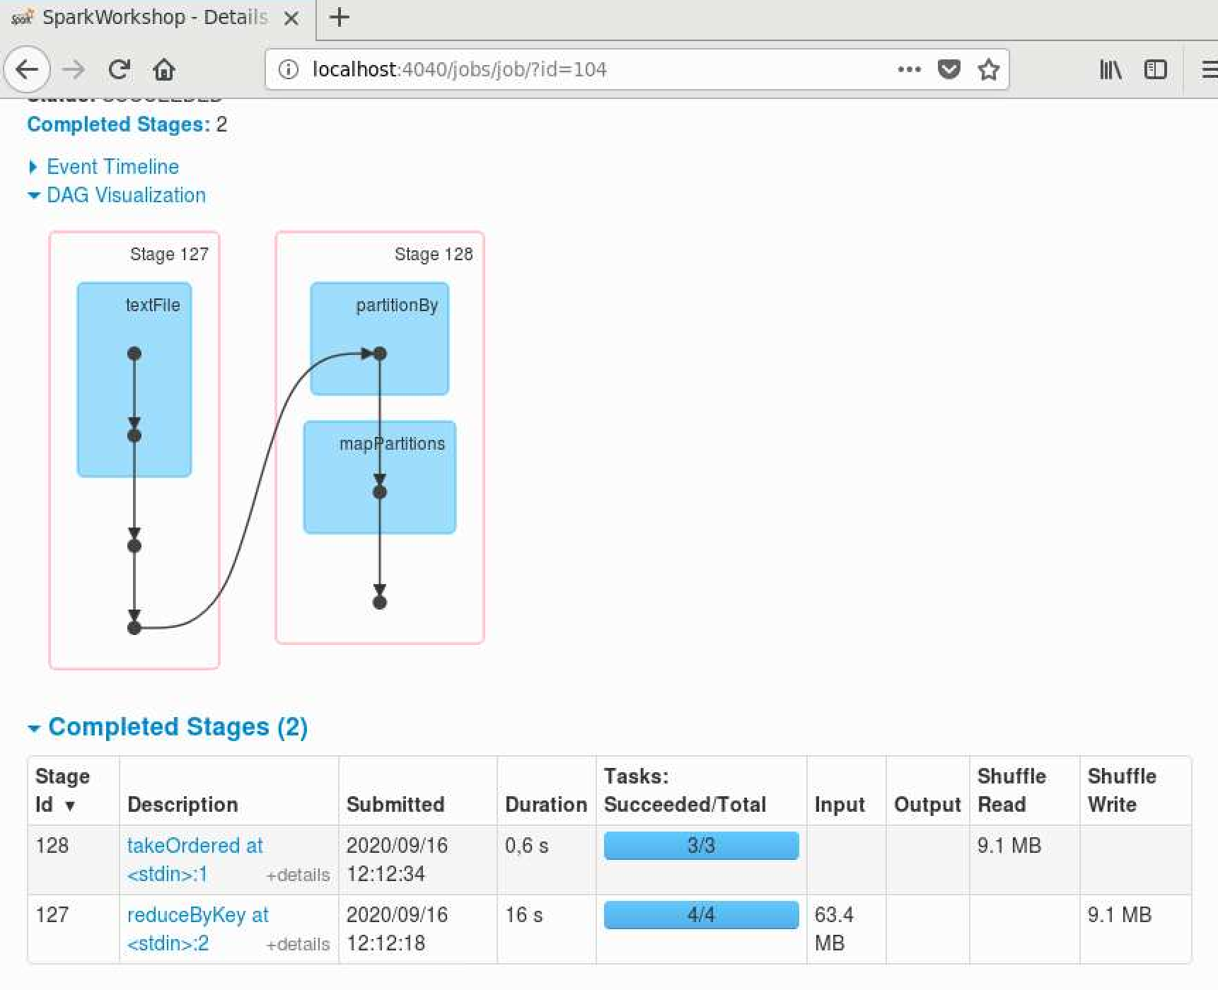
RDDs in Spark
DAG exploration (admin console result)
Notes:
Tu je problem, ker CSV ni generiran ok in se pojavljajo napake pri branju,

Slide 42
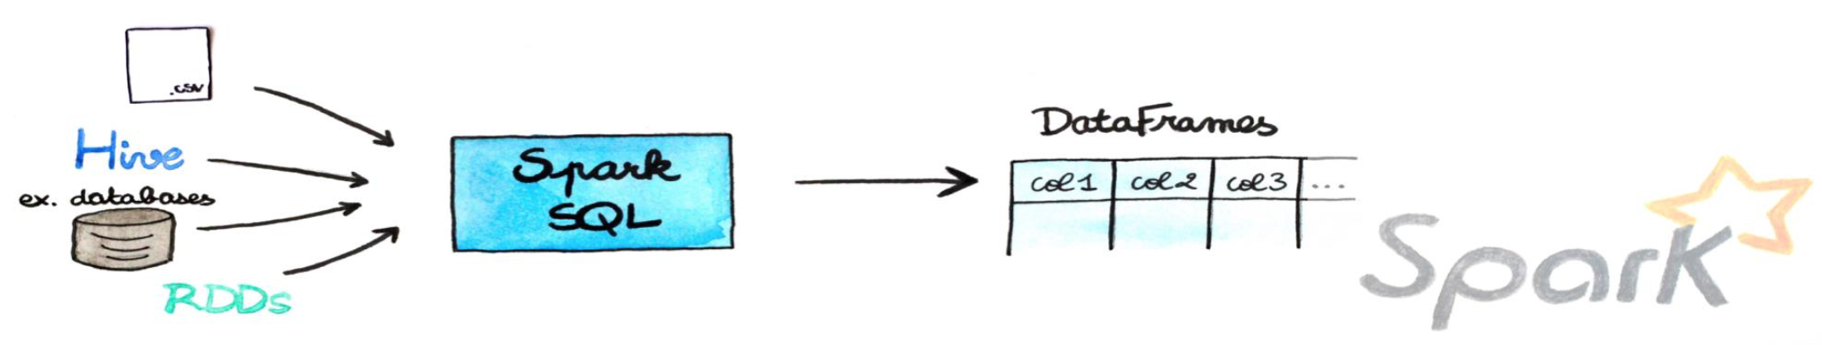
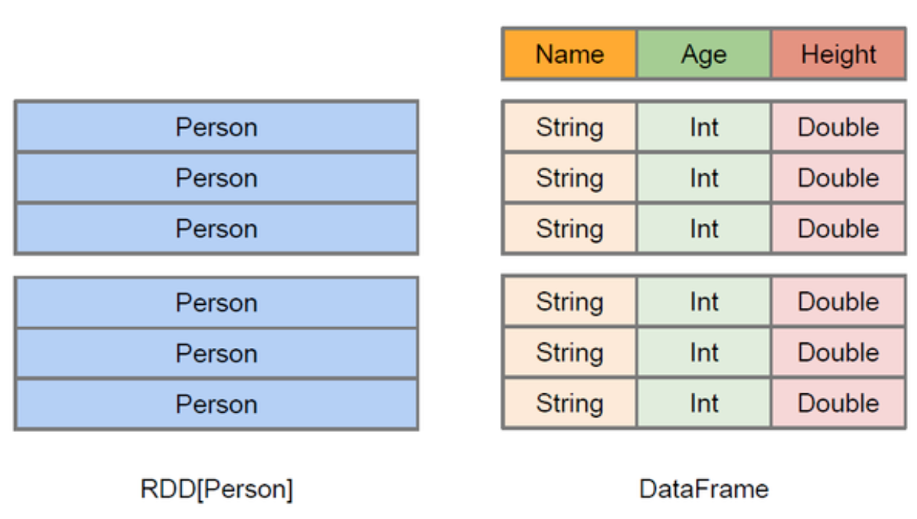
DataFrames (= RDDs + schema) in Spark
Spark SQL enables read/write from/to files, JSON, databases, etc.
DataFrames interoperable with Pandas dataframe
DataFrames creation ...
from pyspark.sql import SQLContext, Row
from pyspark.sql.types import StructType, IntegerType, StringType, StructField
sqlContext = SQLContext(sc)
df1 = sqlContext.createDataFrame(rdd1, ["name", "age"])
ExampleRow = Row("name", "age")
rdd1a = rdd1.map(lambda x: ExampleRow(x[0], x[1]))
df1 = sqlContext.createDataFrame(rdd1a)
Notes:
Tu je problem, ker CSV ni generiran ok in se pojavljajo napake pri branju,

Slide 43
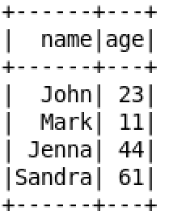
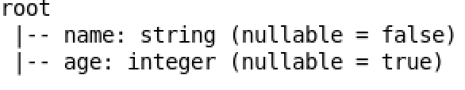
DataFrames (= RDDs + schema) in Spark
... DataFrames creation ...
schema = StructType([StructField("name", StringType(), False), \
StructField("age", IntegerType(), True)])
df1 = sqlContext.createDataFrame(rdd1, schema)
df1.show()
df1.printSchema()
Notes:
Tu je problem, ker CSV ni generiran ok in se pojavljajo napake pri branju,

Slide 44
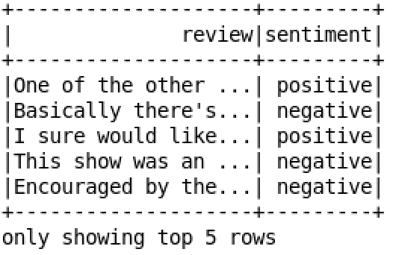
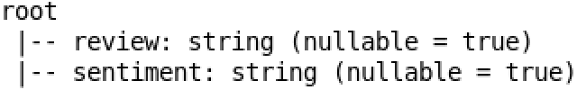
DataFrames (= RDDs + schema) in Spark
... DataFrames creation
df2 = sqlContext.read.format('csv').option('header', 'true'). \
option('mode', 'DROPMALFORMED').load('data/IMDB Dataset.csv')
df2.show(5)
df2.printSchema()
Notes:
Tu je problem, ker CSV ni generiran ok in se pojavljajo napake pri branju,

Slide 45
DataFrames and User Defined Functions (UDF) in Spark
User defined functions are custom functions to run against the "database" directly
Caveats
Optimization problems (especially in pySpark!)
Special values handling by the programmer (e.g. null values)
Approaches to use UDFs
df = df.withColumn
df = sqlContext.sql("SELECT * FROM <UDF>")
rdd.map(UDF())
Notes:
Tu je problem, ker CSV ni generiran ok in se pojavljajo napake pri branju,

Slide 46
DataFrames and User Defined Functions (UDF) in Spark
Examples
from pyspark.sql.functions import udf
reviewLen = udf(lambda r: len(r), IntegerType())
reviewSnippet = udf(lambda r: r[0:50] + ' ...', StringType())
df2 = df2.withColumn('reviewLength', reviewLen('review'))
df2 = df2.withColumn('reviewSnippet', reviewSnippet('review'))
Notes:
Tu je problem, ker CSV ni generiran ok in se pojavljajo napake pri branju,

Slide 47
DataFrames and User Defined Functions (UDF) in Spark
Examples
def words(review, type = 'positive'):
sentimentWords = ['good', 'great', 'nice', 'awesome']
if type == 'negative':
sentimentWords = ['bad', 'worst', 'ugly', 'scary']
return sum(map(lambda w: review.count(w), sentimentWords))
positiveWords = udf(lambda r: words(r), IntegerType())
negativeWords = udf(lambda r: words(r, 'negative'), IntegerType())
df2 = df2.withColumn('positiveWords', positiveWords('review'))
df2 = df2.withColumn('negativeWords', negativeWords('review'))
df2 = df2.drop('review')
Notes:
Tu je problem, ker CSV ni generiran ok in se pojavljajo napake pri branju,

Slide 48
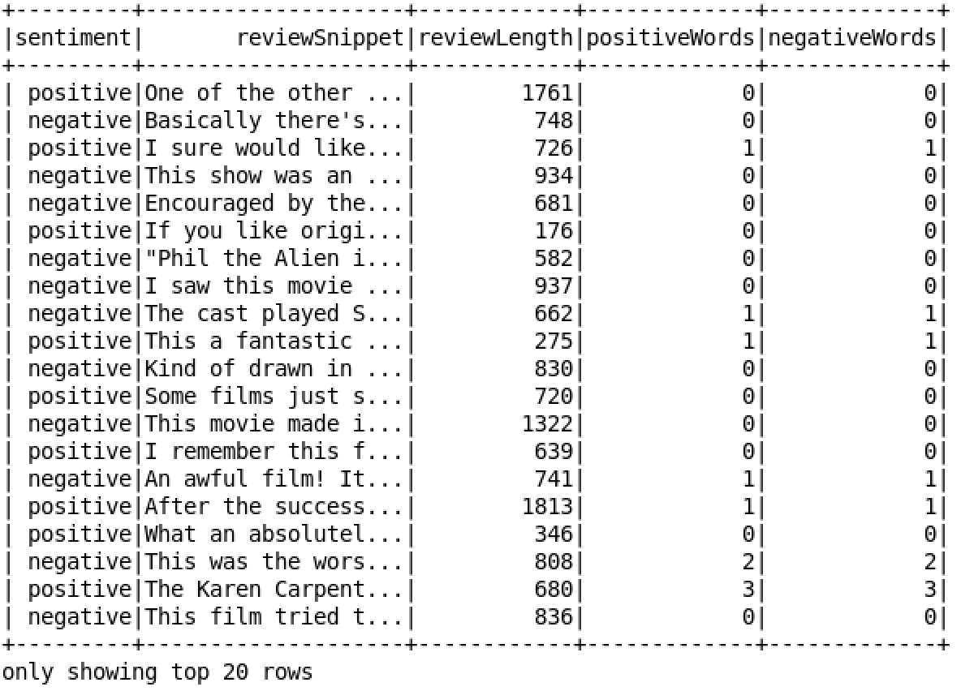
DataFrames and User Defined Functions (UDF) in Spark
Examples
df2.cache().show()
Notes:
Tu je problem, ker CSV ni generiran ok in se pojavljajo napake pri branju,

Slide 49
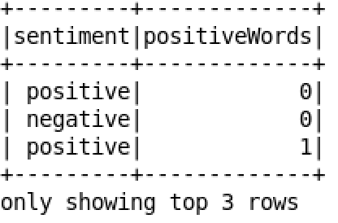
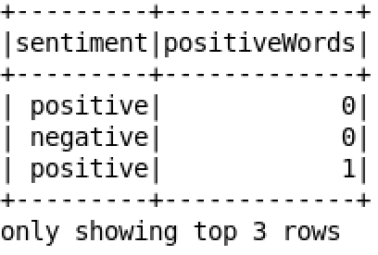
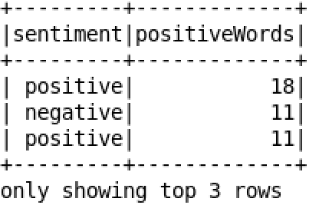
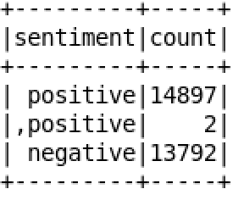
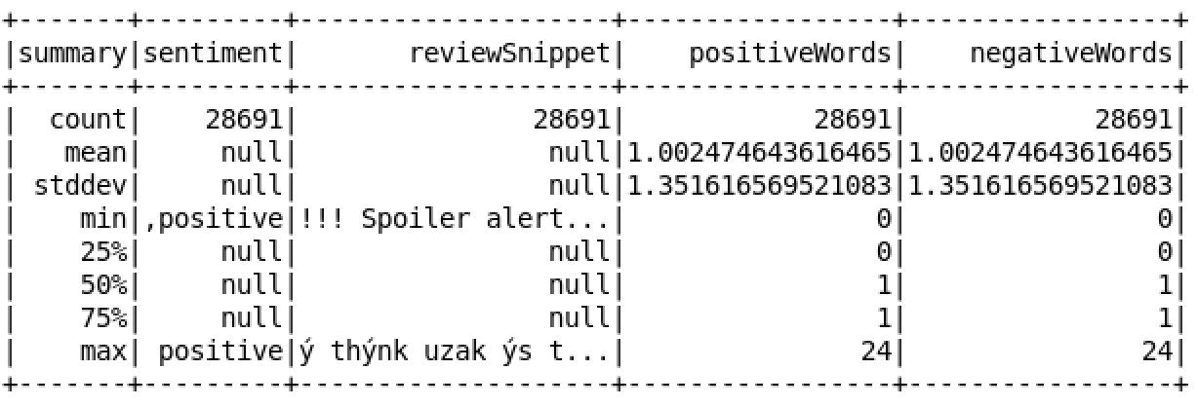
Spark SQL DataFrame operations
Examples
df2.select('sentiment', 'positiveWords').show(3)
df2.select(df2['sentiment'], df2['positiveWords']).show(3)
df2.select(df2['sentiment'], df2['positiveWords']). \
filter(df2['positiveWords'] > 10).show(3)
df2.groupBy('sentiment').count().show()
df2.summary().show()
Notes:
Tu je problem, ker CSV ni generiran ok in se pojavljajo napake pri branju,

Slide 50
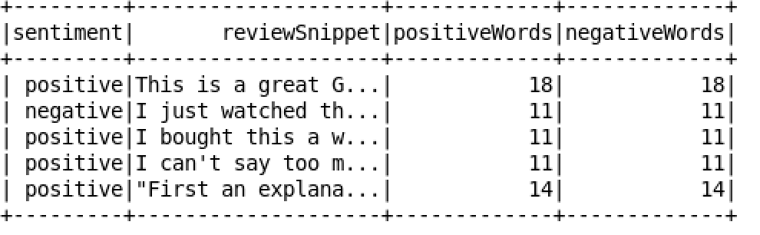
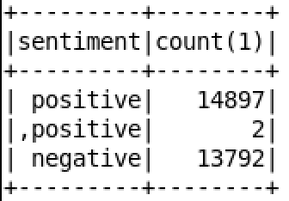
Spark SQL SQL operations
Examples
df2.createOrReplaceTempView('imdb')
sqlContext.sql('SELECT * FROM imdb WHERE positiveWords > 10 LIMIT 5').show()
sqlContext.sql('SELECT sentiment, count(*) FROM imdb GROUP BY sentiment').show()
Notes:
Tu je problem, ker CSV ni generiran ok in se pojavljajo napake pri branju,

Slide 51
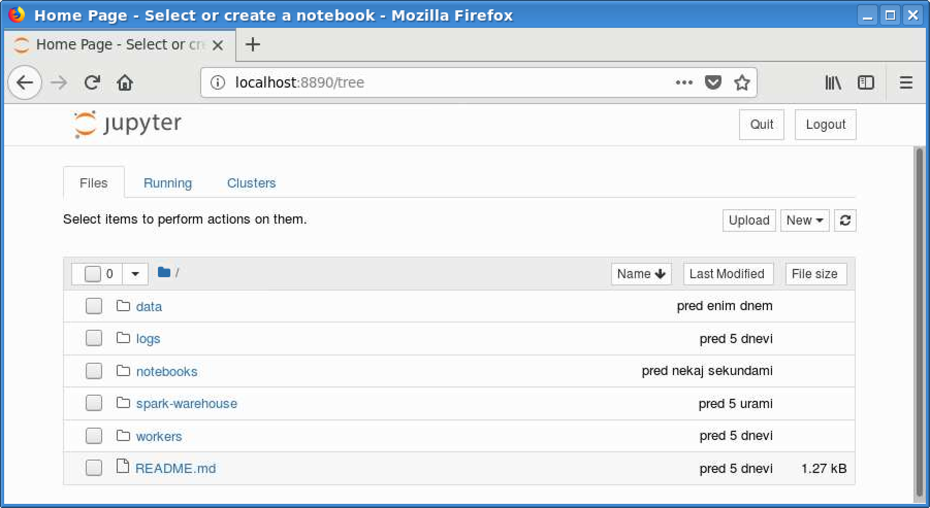
Lab exercises - Jupyter
Run jupyter notebook command in the project folder and run notebooks from notebooks folder

Slide 52
Challenge exercises
Run Lab 1 notebook
Run it using embedded Spark within PySpark
Setup a Spark cluster and run Lab 1 script using it (check further slides)
Solve Spark Pi notebook
Solve Lab 2 notebook challenge
Train a classifier to predict movie review sentiment
Use the provided IMBD reviews.csv data an split it to train and test set
Extract features (e.g. TF-IDF), train model (e.g. SVM) and test it
See MLlib documentation at https://spark.apache.org/docs/latest/ml-guide.html
Try using Spark on an HPC (check further slides) (why not offered by default in HPCs?)

Slide 53
Lab 1 – Spark cluster submit
Download and unpack Spark binaries
https://downloads.apache.org/spark/spark-3.1.1/spark-3.1.1-bin-hadoop2.7.tgz
Start master node
./sbin/start-master.sh
Check log to find out Spark master endpoint and Web UI URL
Start worker nodes
SPARK_WORKER_INSTANCES=1 SPARK_WORKER_CORES=1 SPARK_WORKER_MEMORY=2g ./sbin/start-slave.sh spark://localhost:7077
Update Lab 1 notebook (SparkConf) and save it as Python script

Slide 54
Lab 1 – Spark cluster submit
Submit script as a Spark job
./bin/spark-submit --master spark://localhost:7077 Lab-1.py
Observe the driver output
Stopping Spark
Stop driver
Stop slaves
SPARK_WORKER_INSTANCES=1 SPARK_WORKER_CORES=1 SPARK_WORKER_MEMORY=2g ./sbin/stop-slave.sh spark://localhost:7077
Stop master
./sbin/stop-master.sh

Slide 55
Lab exercise – Spark on an HPC
Follow tutorial after this slide.
Use more nodes with workers on an HPC
Adapt HPC lab exercise to be run on multiple nodes
Hint: https://info.gwdg.de/wiki/doku.php?id=wiki:hpc:slurm_sbatch_script_for_spark_applications
Viewing event logs in the SparkUI after Slurm job is finished
Replicate the HPC exercise from before, retrieve logs and run history server to explore SparkUI
Hints: https://researchcomputing.princeton.edu/faq/spark-via-slurm

Slide 56
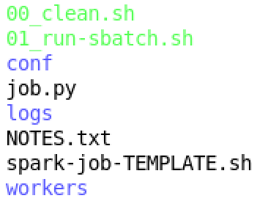
Lab exercise – Spark on an HPC
Move to spark-hpc folder:
00_clean.sh
Script to clean logs, data generated by running scripts
01_run-sbatch.sh
Prepare and submit scripts with a Spark job
conf/spark-env.sh
Env variables for worker folder and log folder set
job.py
Pyspark source code (i.e. simple pi calculation script)
logs/
Spark and slurm log folder
NOTES.txt
Short Slurm commands reference
spark-job-TEMPLATE.sh
Slurm script for job submission
workers/
Workers working directories

Slide 57
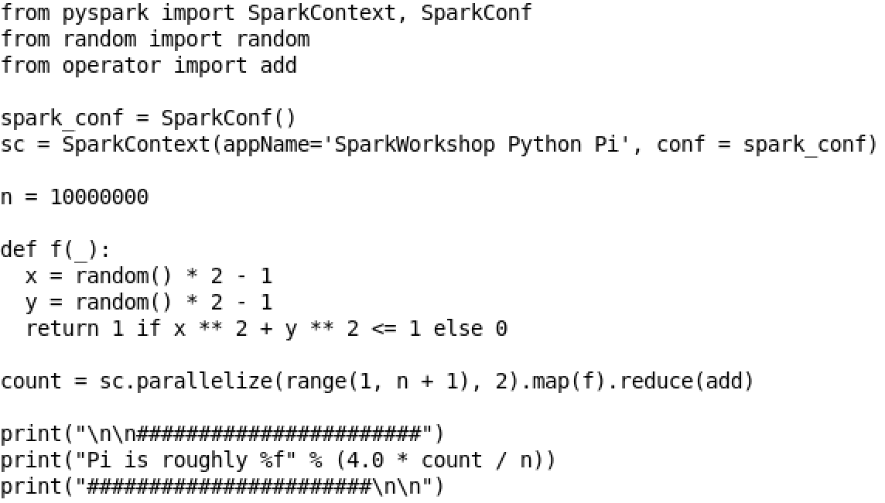
Lab exercise – Spark on an HPC
job.py

Slide 58
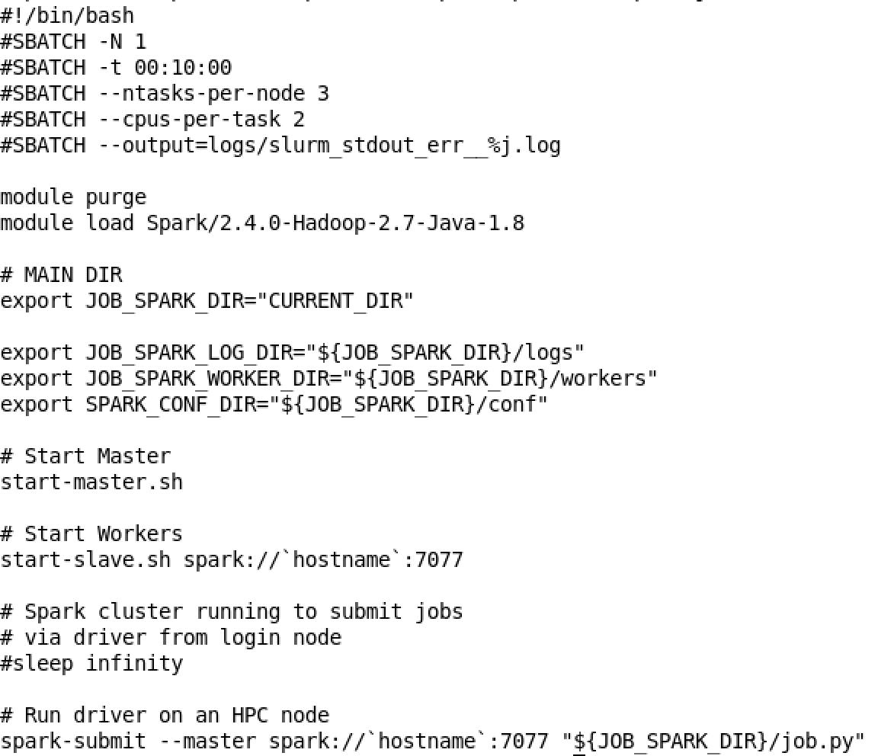
Lab exercise – Spark on an HPC
spark-job-TEMPLATE.sh

Slide 59

Lab exercise – Spark on an HPC
01_run-sbatch.sh

Slide 60

Lab exercise – Spark on an HPC
Run spark application on an HPC (commands):
./01_run-sbatch.sh
squeue -u campus02
sacct -j 51438

Slide 61

Lab exercise – Spark on an HPC
Check the output log:
cat logs/slurm_stdout_err__51438.log

Slide 62
References
https://training.databricks.com/visualapi.pdf
https://events.prace-ri.eu/event/896/
https://luminousmen.com/post/spark-core-concepts-explained
https://info.gwdg.de/wiki/doku.php?id=wiki:hpc:slurm_sbatch_script_for_spark_applications
https://researchcomputing.princeton.edu/faq/spark-via-slurm

Slide 63
THANK YOU FOR YOUR ATTENTION

